Slide 1


Evaluation of metabolomic sample processing methods using hierarchical cluster analysis
Goal:
Use hierarchical cluster analysis (HCA) to evaluate data variance structure
Topics:
Evaluate sample and variable similarities
Identify the effect of data transformation, distance and linkage methods on data similarities
Cluster Analysis

Slide 2
Clustering data
Use DATA: Pumpkin data 1.csv
Goal: Use HCA to cluster samples
Visualize:
Sample (row) raw similarities as a heat map
Annotate heatmap with extraction and treatment type
Select cluster distance and linkage method to cluster the samples
Determine the effect of data transformations on the cluster structure
(view as a dendrogram)
Exercises:
What factor, extraction or treatment, has the greatest contribution to the data variance structure?
Describe the effect of clustering raw data or sample correlations
Cluster Analysis

Slide 3
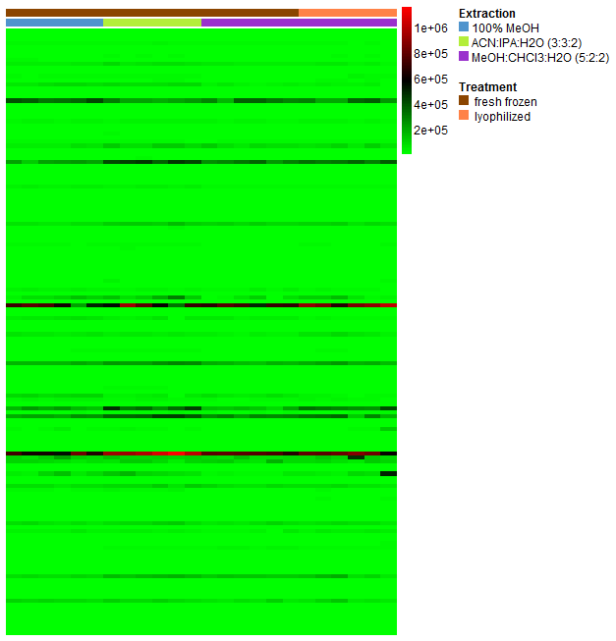
Raw data matrix visualized as a heatmap
samples
variables
Cluster Analysis

Slide 4
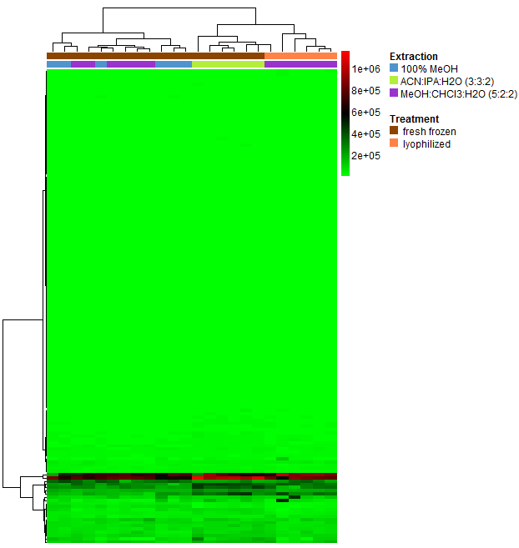
Raw data matrix organized by HCA
ACN:/IPA/water|fresh and MeOH/CH3Cl/water|dried display distinct patterns in metabolites which are most similar to each other
Sample similarities are linked to metabolite magnitudes
Cluster Analysis

Slide 5
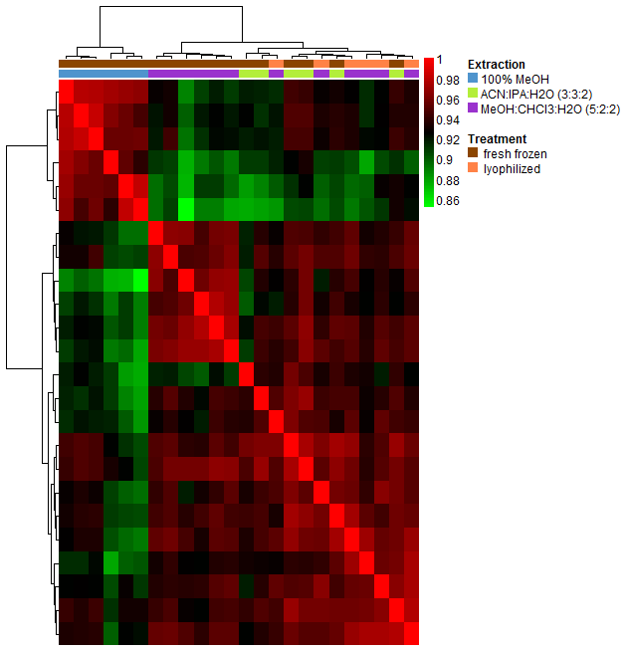
Clustering based on sample correlations (spearman)
100% MeOH/fresh is the most dissimilar protocol from all others
ACN:/IPA/water and MeOH/CH3Cl/water are most similar to each other
Sample similarities are decoupled from metabolite magnitudes
Cluster Analysis

Slide 6
Clustering metabolites
Goal 2: Use HCA to evaluate metabolite similarities
Visualize:
Z-scaled and correlation based variable clustering
Use a dendrogram to extract variable clusters
Select two variables from the same cluster and visualize their correlation
Exercise:
Do the clustered variables share biological functions?
Which type of correlation is most robust to outliers?
Are the correlations for the visualized variable independent of extraction/treatment?
Cluster Analysis

Slide 7
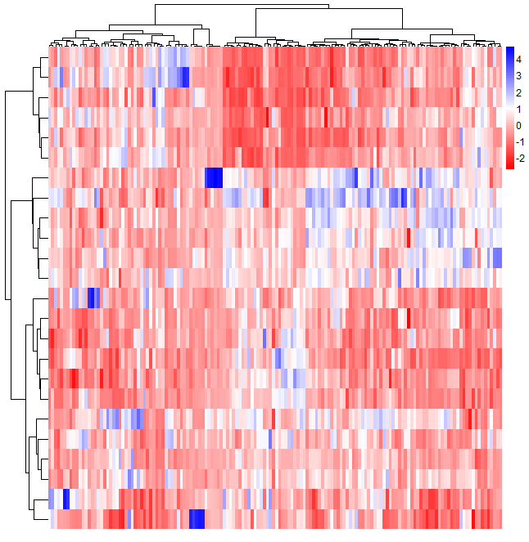
Z-scaled variable clusters
Cluster Analysis

Slide 8
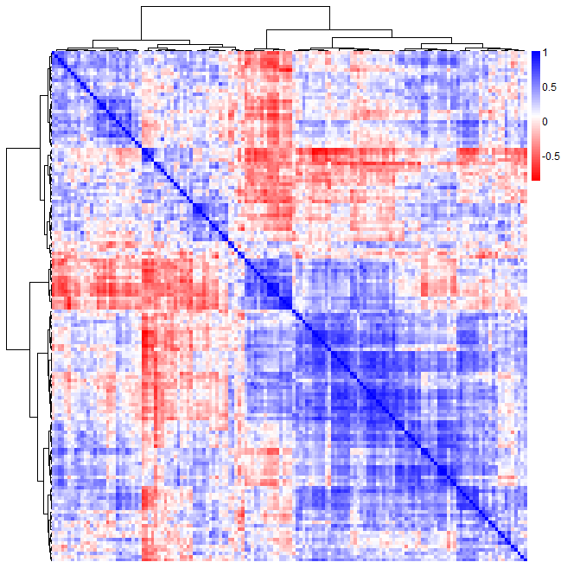
Correlation based variable clusters
Cluster Analysis

Slide 9
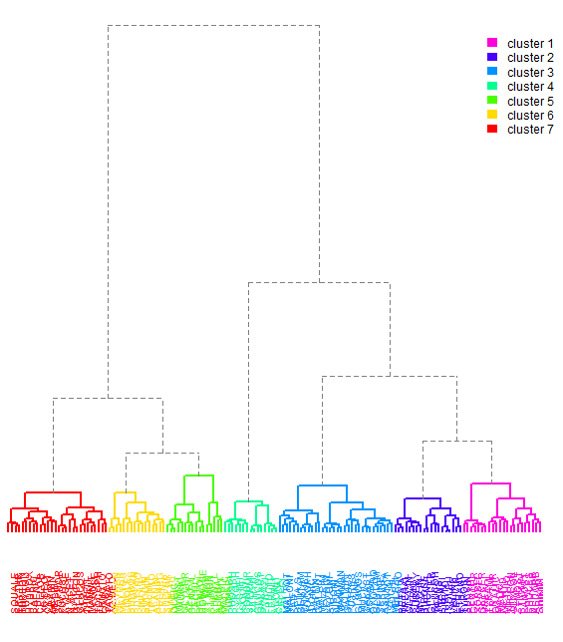
Extraction of clusters of correlated variables
less similar
most similar cluster
lowest common branch height
Cluster Analysis
more similar

Slide 10
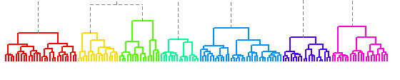
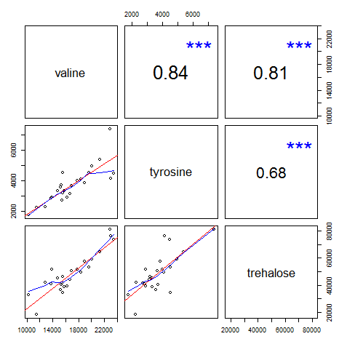
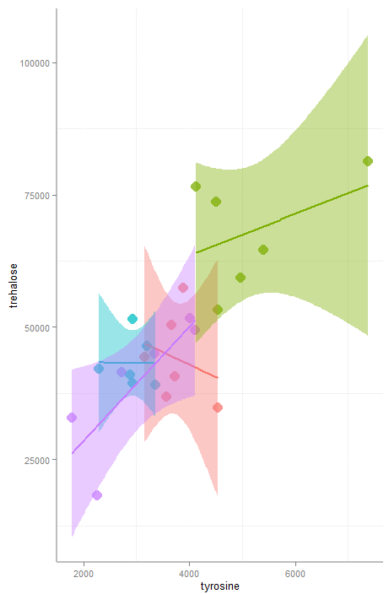
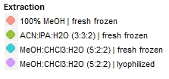
Correlation among cluster members (4)
Cluster Analysis

